Slide 1
Breakneck
Wireless & Mobile networks
Earable based gesture recognition system
Presented by:
Murtaza Mister
Eshwar chaItanya Sarampati

Slide 2
Let’s talk data

Slide 3
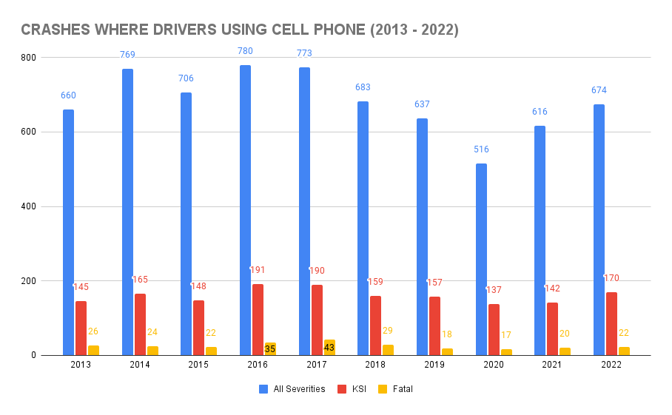
Let’s talk data

Slide 4
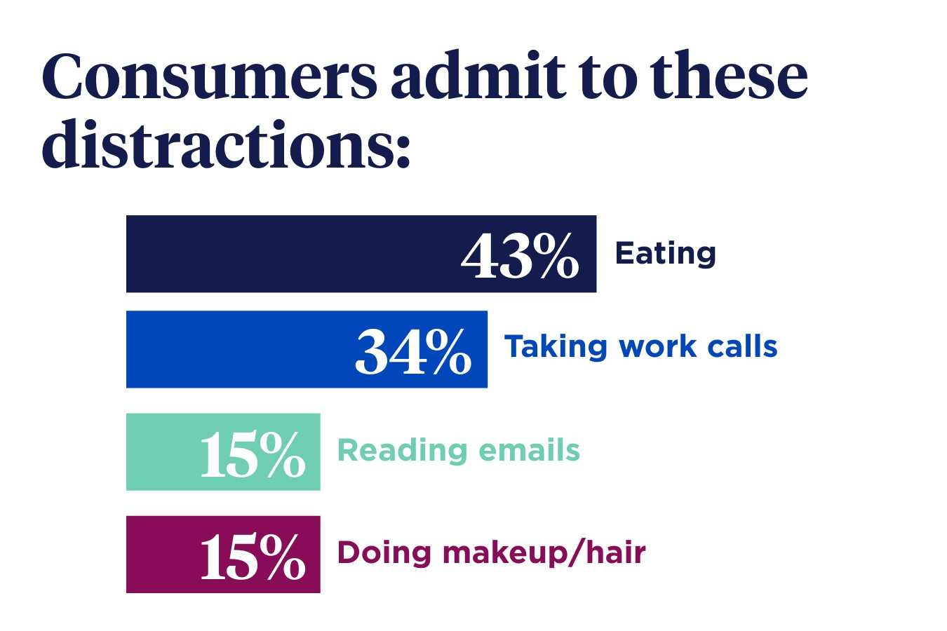
Let’s talk data

Slide 5

Let’s talk data

Slide 6
Pain point identified

Slide 7
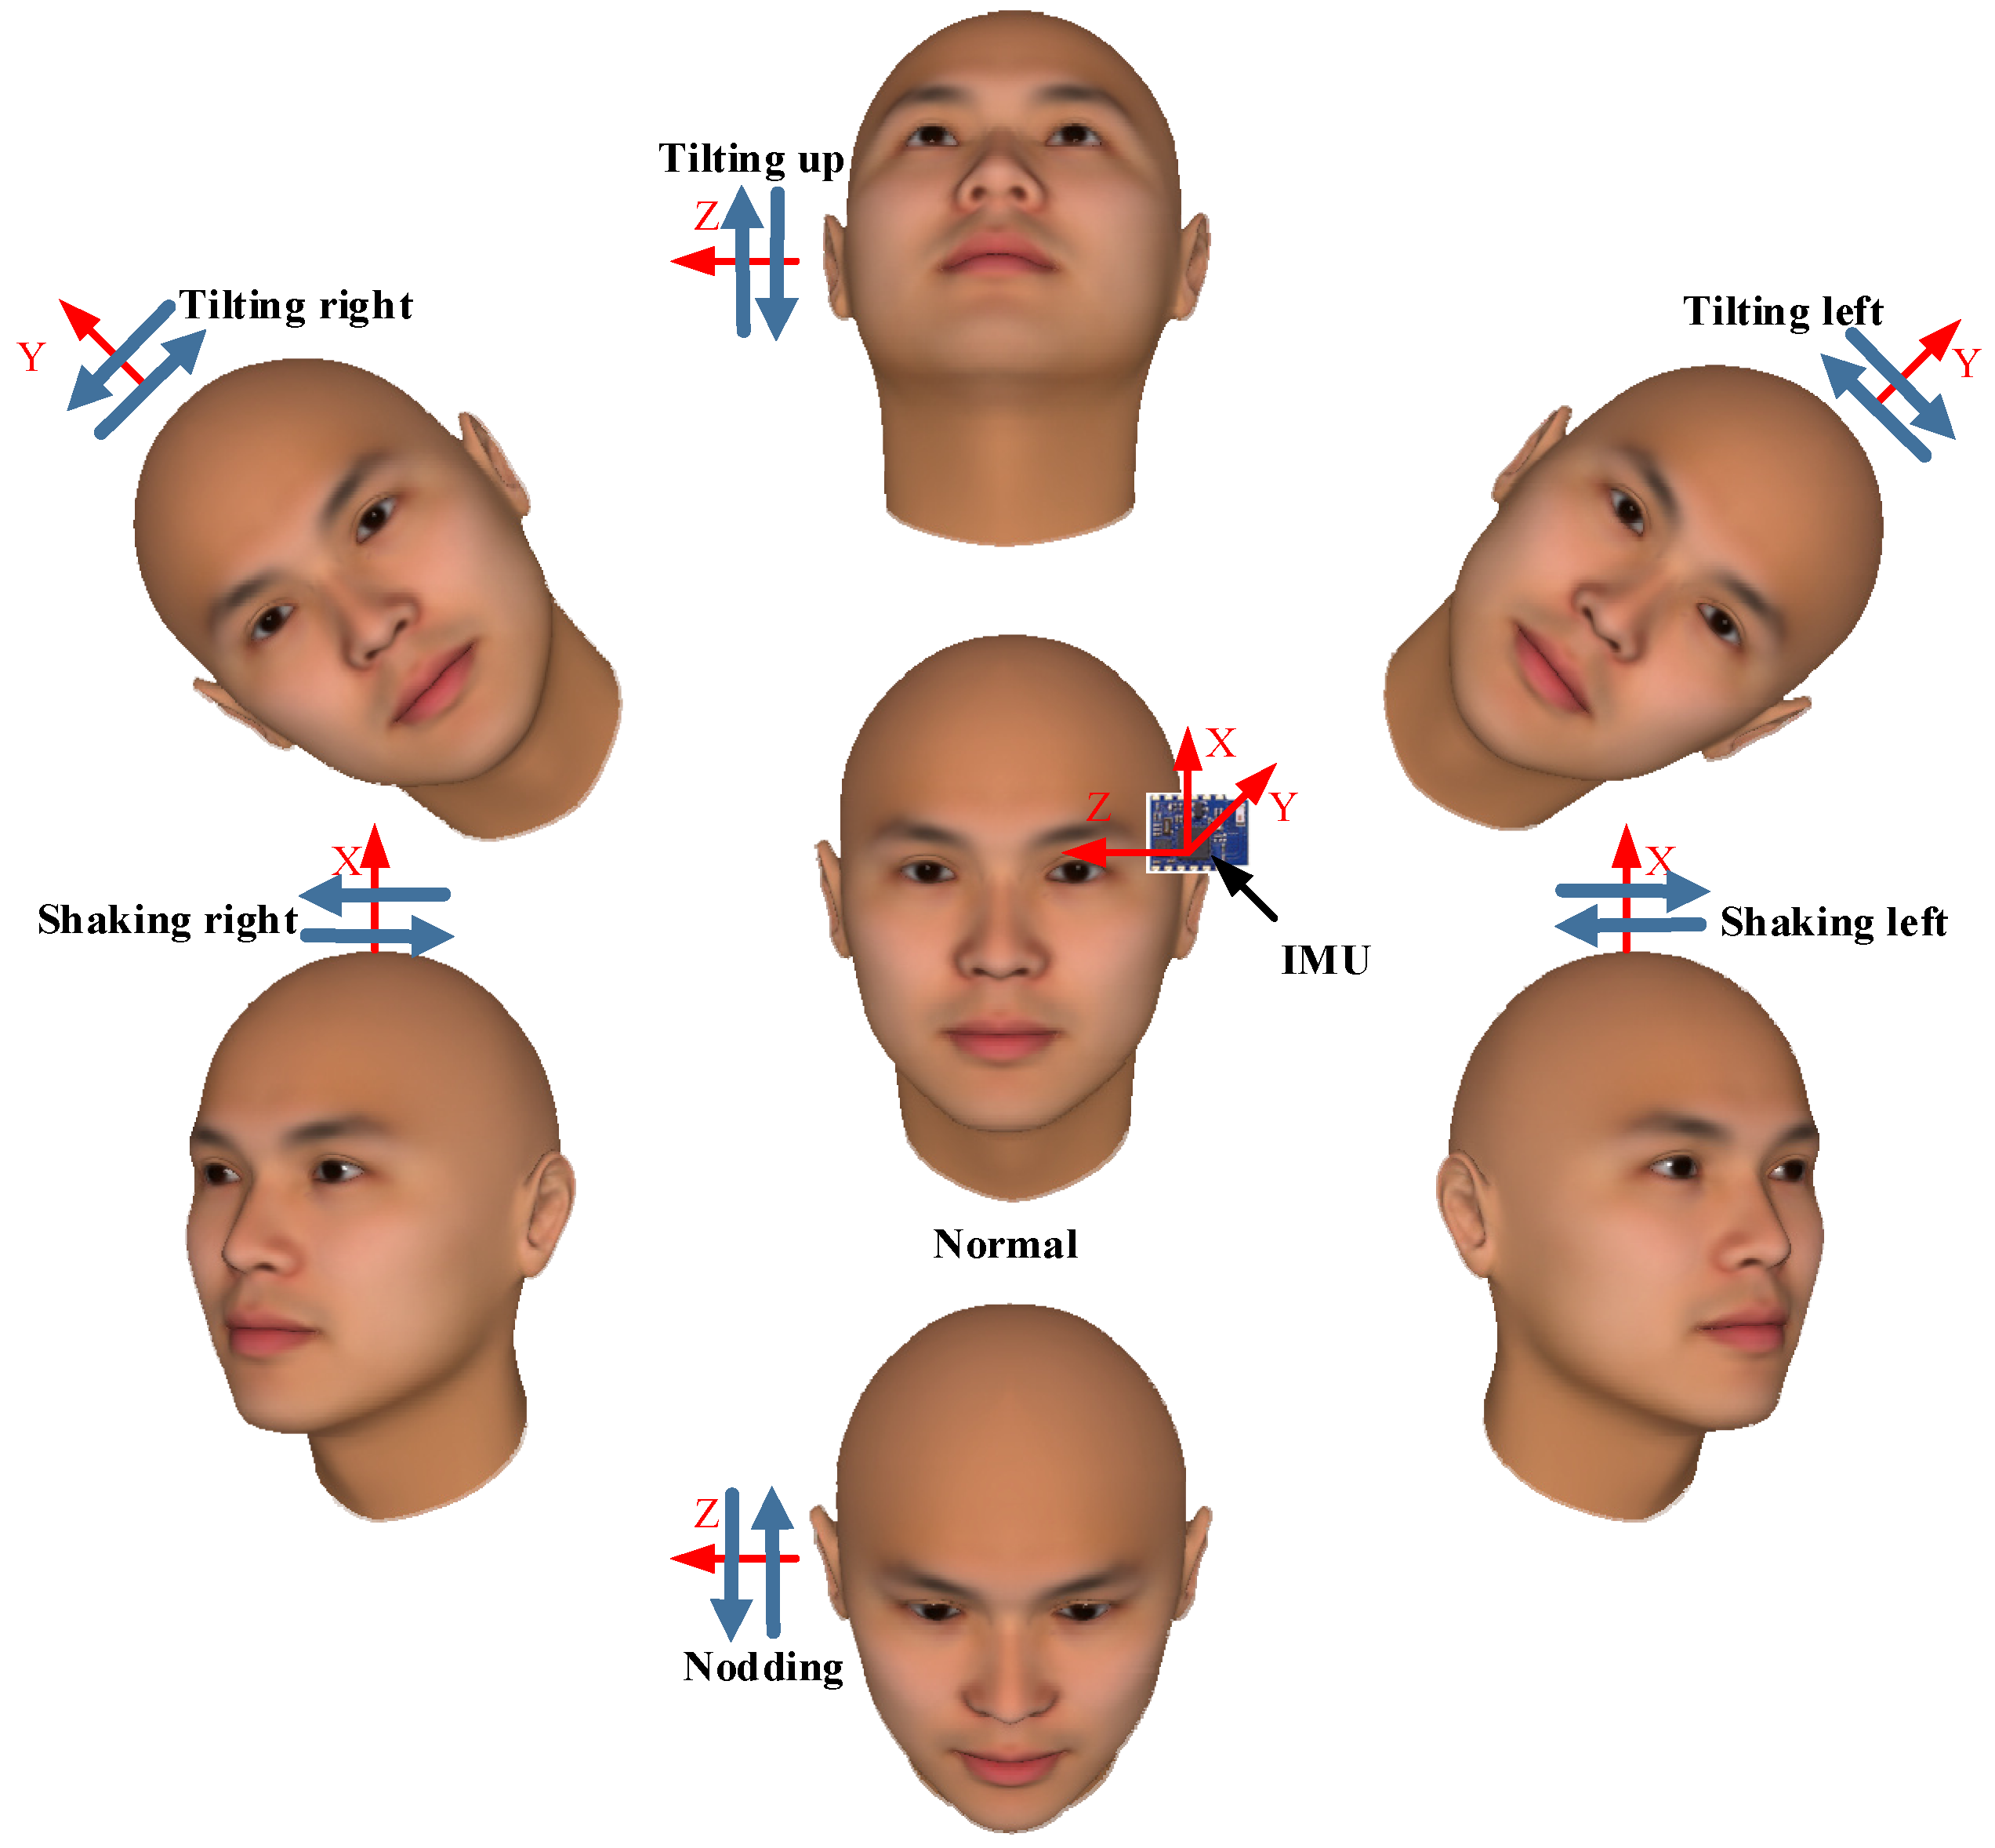
solution

Slide 8
Why us?

Slide 9
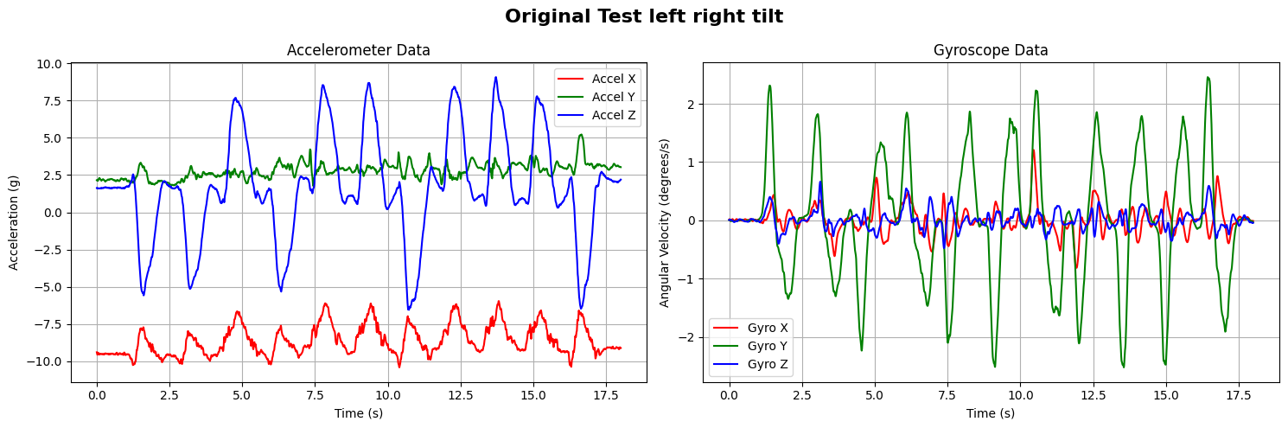
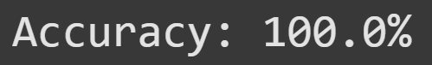
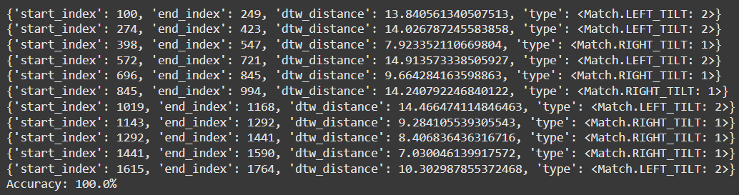
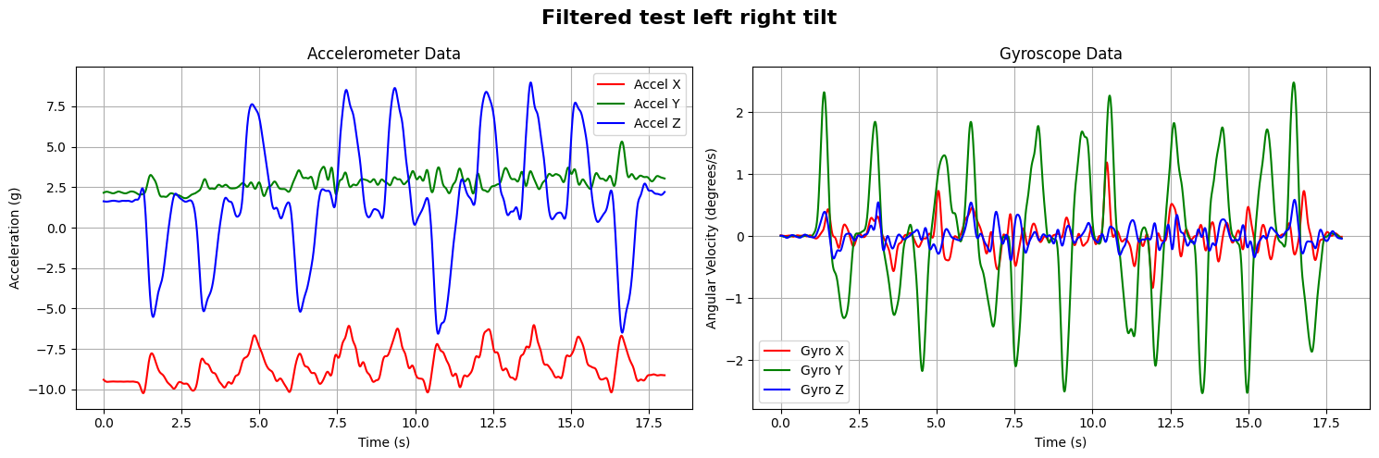
Left-right while sitting

Slide 10
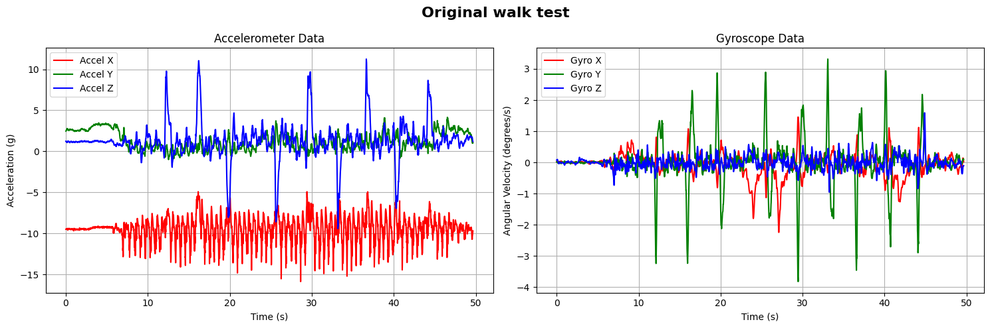
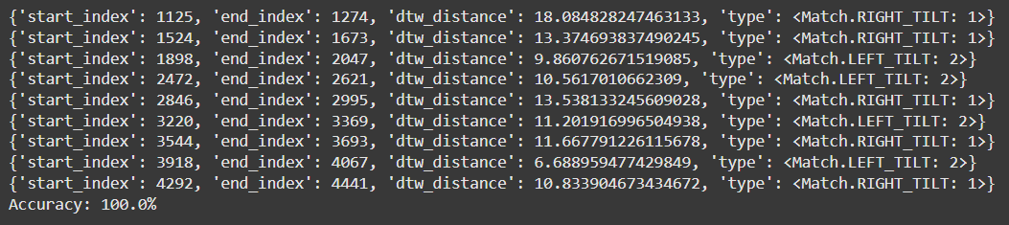
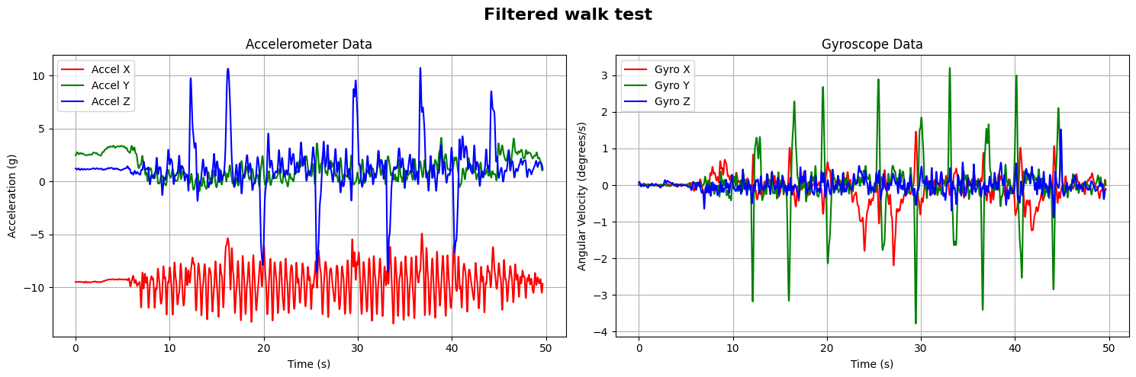
Left-right while walking

Slide 11
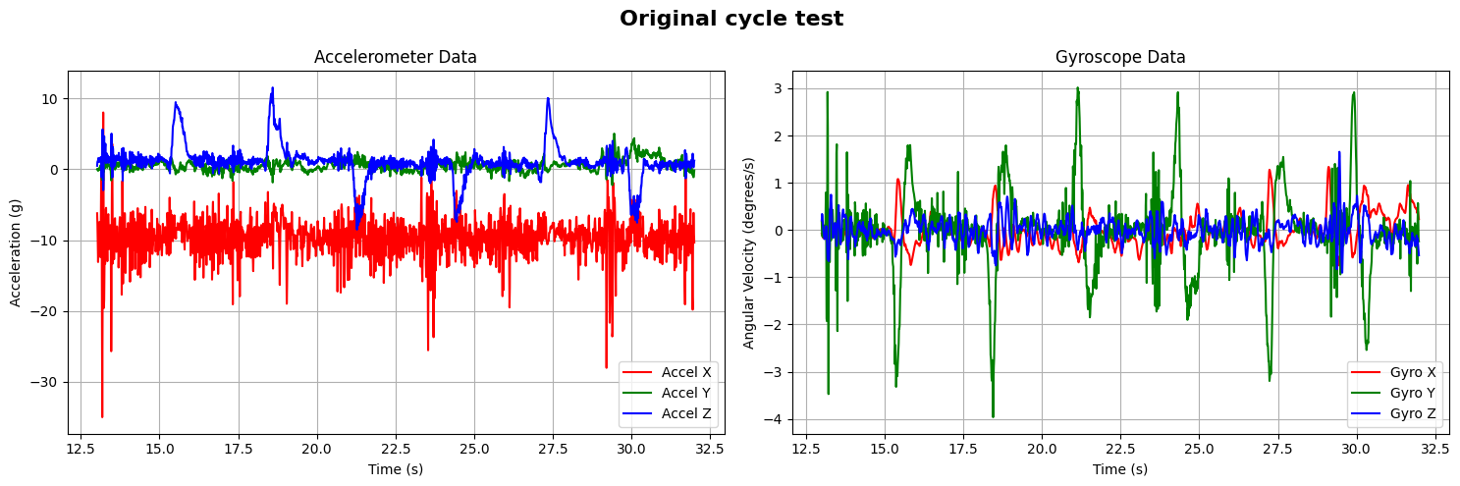
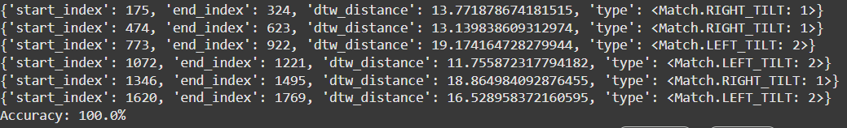
Left-right while cycling

Slide 12
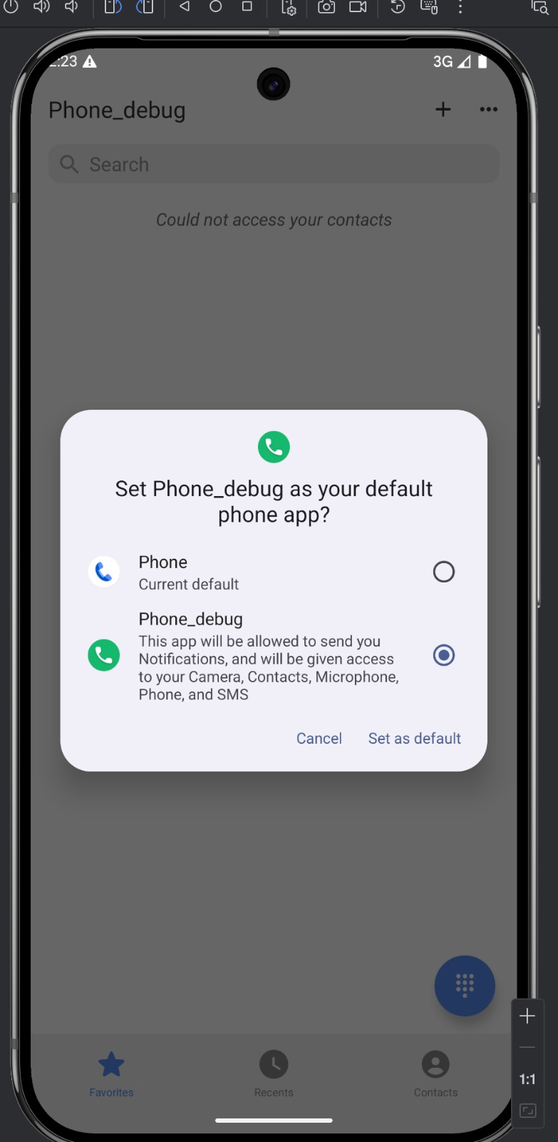
setup

Slide 13
setup

Slide 14
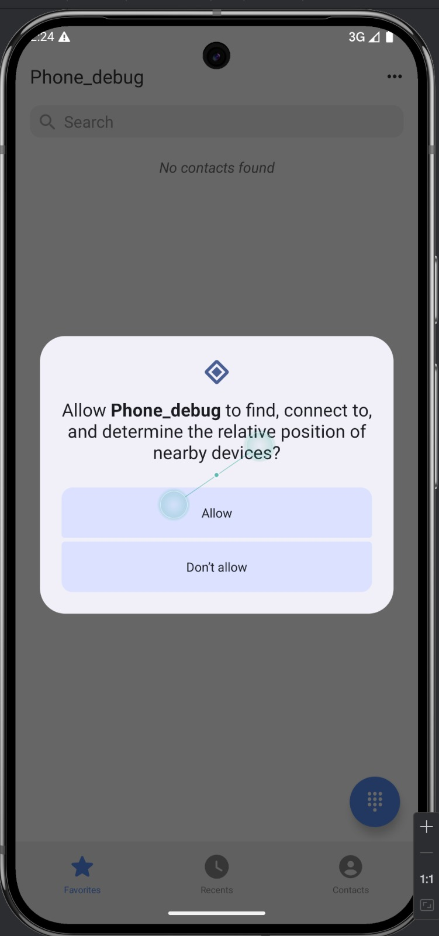
setup

Slide 15
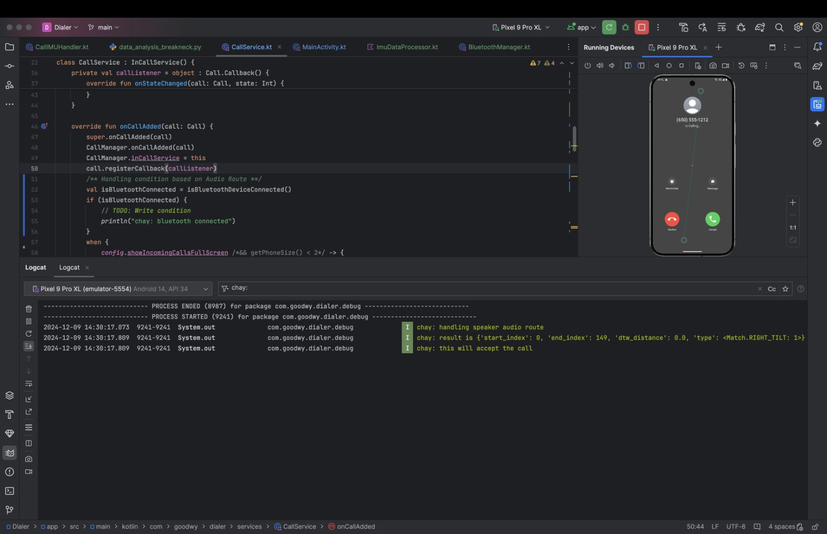
usage

Slide 16
usage

Slide 17
usage

Slide 18
usage

Slide 19
usage

Slide 20
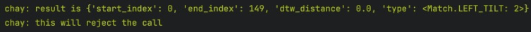
usage

Slide 21
usage

Slide 22
usage

Slide 23
Its that simple!

Slide 24
Additionally!

Slide 25
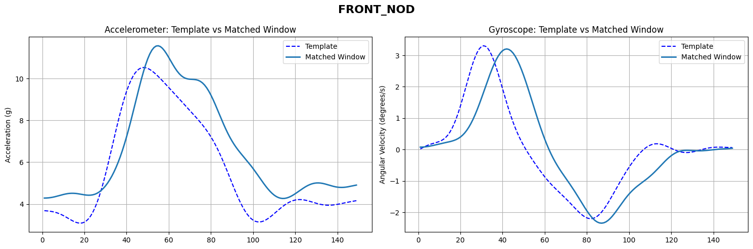
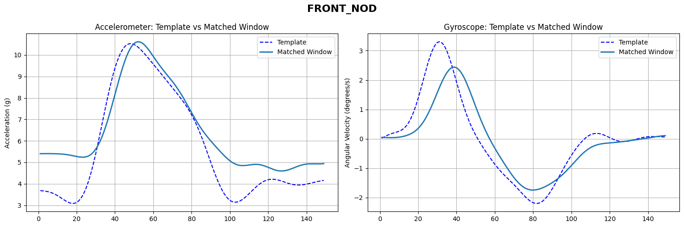
Front nod

Slide 26
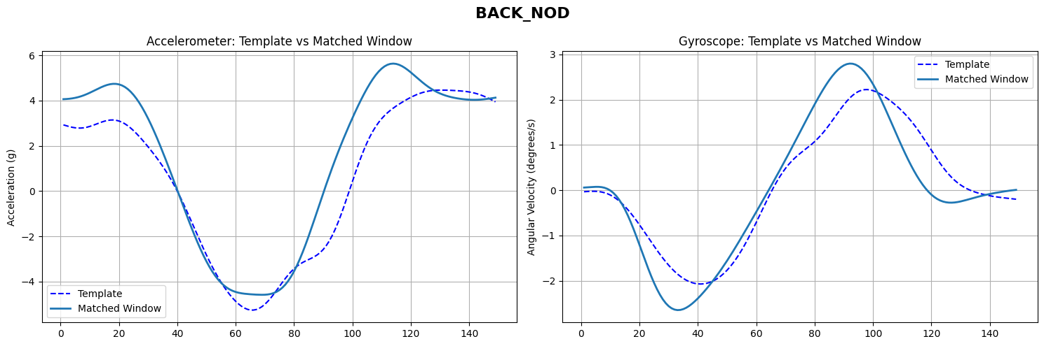
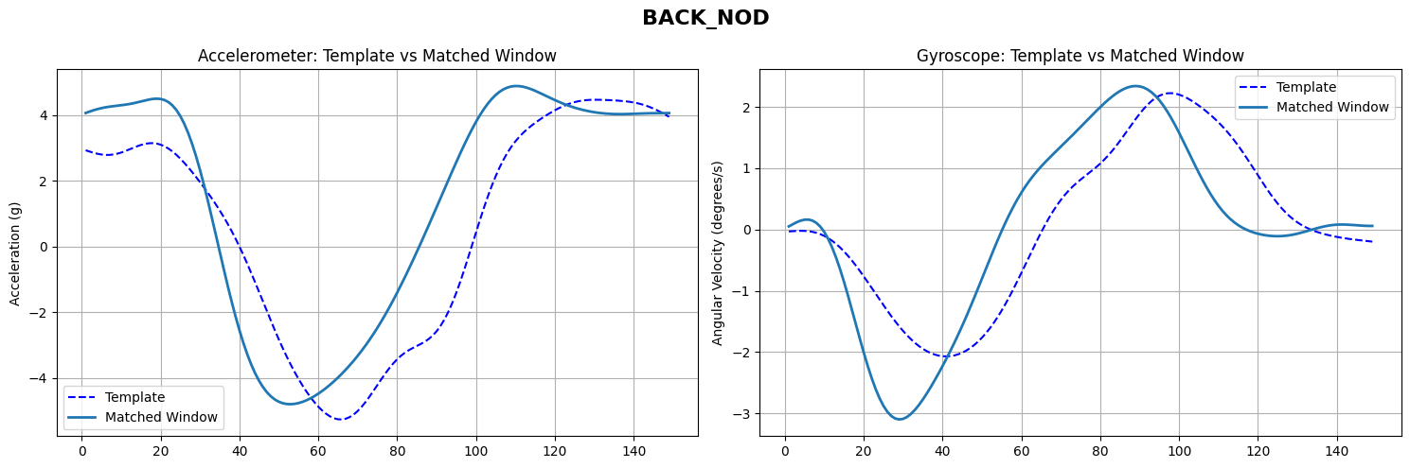
Back nod

Slide 27
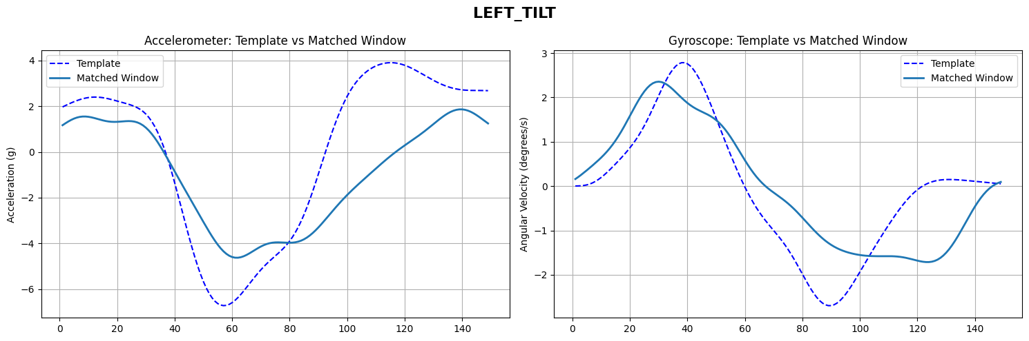
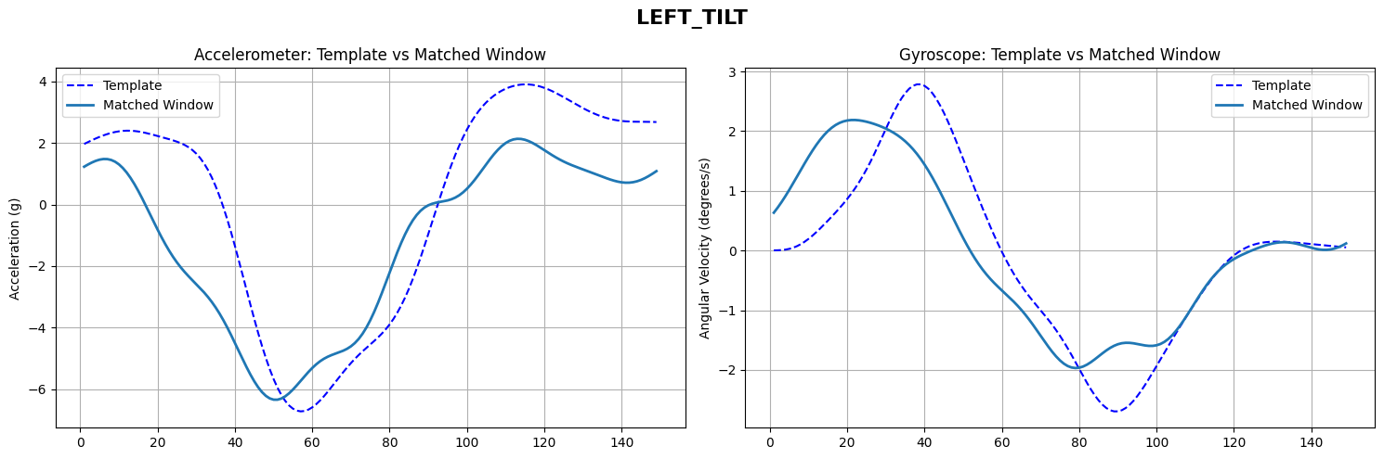
Sleeping left tilt

Slide 28
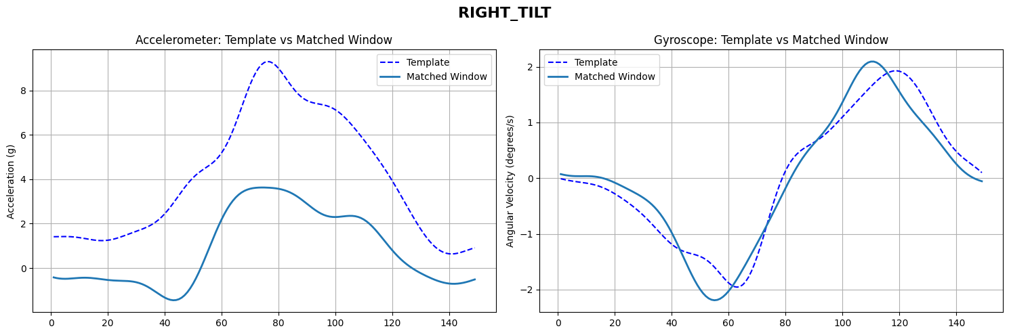
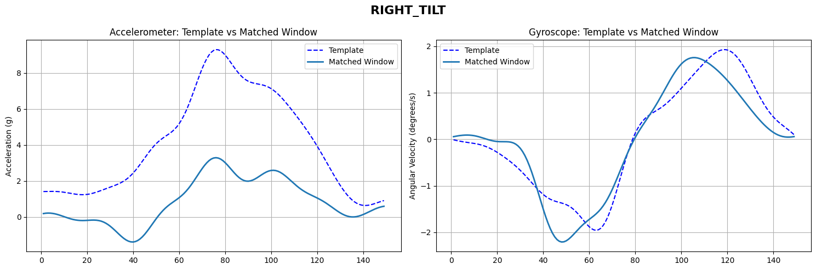
Sleeping Right tilt

Slide 29
THANK YOU
Murtaza Mister
Eshwar Chaitanya Sarampati

